Slide 1
MACHINE LEARNING PROJECTS:
PREDICTING RESTAURANTS SURVIVAL
Aldaheir Leonardo De Jesus
Nomakhephu Nomcoyiya

Slide 2
PURPOSE
This project builds a machine learning model that predicts whether a restaurant is still OPEN (0) or has CLOSED (1), using ratings, reviews, and location/business features.
We compare three standard ML methods and evaluate them with balanced accuracy.

Slide 3
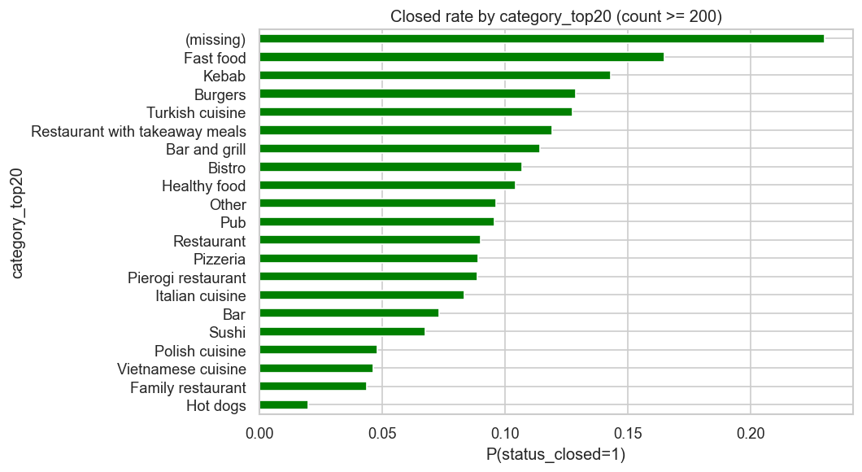
THE DATA
The training set has 33,296 restaurants.
Each row is labeled with status_closed: 0 = open, 1 = closed (training data).
Features include ratings, review history, location and catchment variables, opening hours, and categorical business attributes.
The test set has 8,325 restaurants with the same kinds of features but no status_closed label.
The training labels are imbalanced: about 10% closed and 90% open. That shape of the data drives our choice of balanced accuracy and stratified splits later in the project.

Slide 4
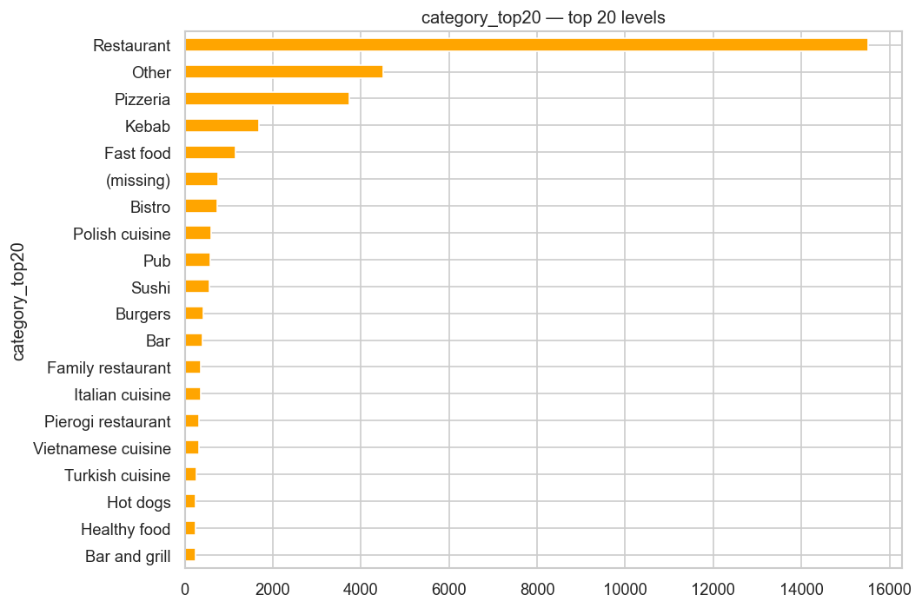
SPLITS AND PRE-PROCESSING
Data are split 70% train / 15% validation / 15% internal test, with stratification so each part keeps roughly the same share of closed restaurants.
High-missing columns are dropped
Skewed counts are log-transformed; then we impute, scale, and one-hot encode.

Slide 5
THREE MACHINE LEARNING MODELS
All three models use the same features; only the classifier changes. Hyperparameters are tuned with GridSearchCV, optimizing balanced accuracy with stratified cross-validation.
Logistic regression — L2, class_weight="balanced”
kNN — KNeighborsClassifier (n_neighbors, weights)
Linear SVM — LinearSVC, class_weight="balanced"

Slide 6
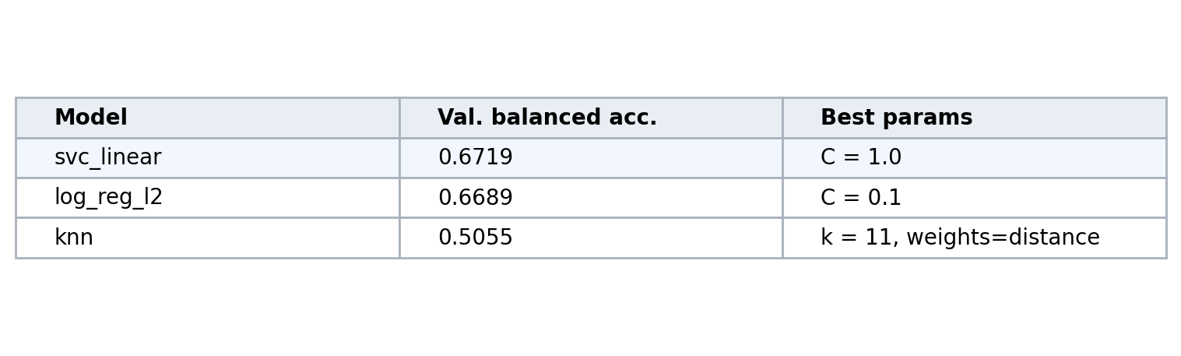
WINNER
Winner chosen by validation balanced accuracy:
Linear SVM: 0.6719 → Logistic: 0.6689 → k-NN: 0.5055
Best SVM hyperparameter: C = 1.0

Slide 7
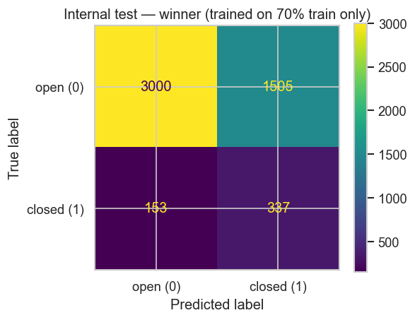
INTERNAL TEST (svc_linear)
Evaluation on the internal 15% hold-out (4,995 rows).
Balanced accuracy: 0.6768
Closed class: recall ≈ 0.69, precision ≈ 0.18 (false alarms)
Open class: precision ≈ 0.95

Slide 8
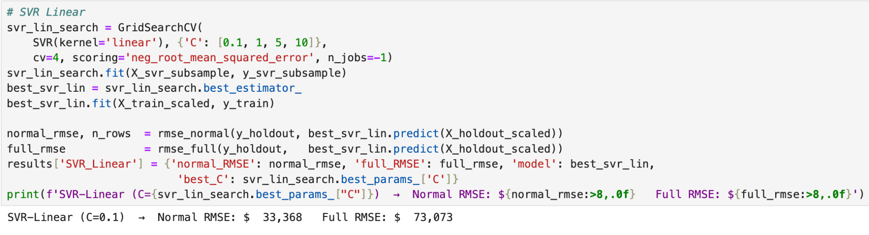
Developer Salary Prediction
2,512 training rows · 329 engineered features · 6 models compared
Best model: SVR Linear · Normal RMSE: $33,368
628 predictions were generated in the final submission file.

Slide 9
Data & Exploratory Analysis
41 raw columns transformed into 329 features
Ordinal encoding: 9 ordered columns (e.g education, company size).
region target encoding which replaced each region code with the mean log-salary of that region and turned out to be the single strongest predictor in the dataset
multi-select encoding for the 15 technology columns which produced roughly 315 binary indicator columns.
Interaction terms: manager × experience · education × experience · region × education
Missingness indicators for 8 high-missing columns
RobustScaler applied and it uses IQR which is resistant to extreme salary values.
Notes:
Interaction terms were also created to capture combined effects like manager times experience.

Slide 10
Validation Strategy & RMSE Metric
70/15/15 split: Train -> Validation -> Holdout
Hyperparameters were tuned on validation set; GridSearchCV and RandomizedSearchCV (CV=5)
Normal RMSE: rows where true salary ∈ [$41 - $177 388)
Full RMSE: all rows including outliers · ~$73,000 · shown for transparency only
Full RMSE inflated by ~39 extreme outlier rows · not a reflection of model quality

Slide 11
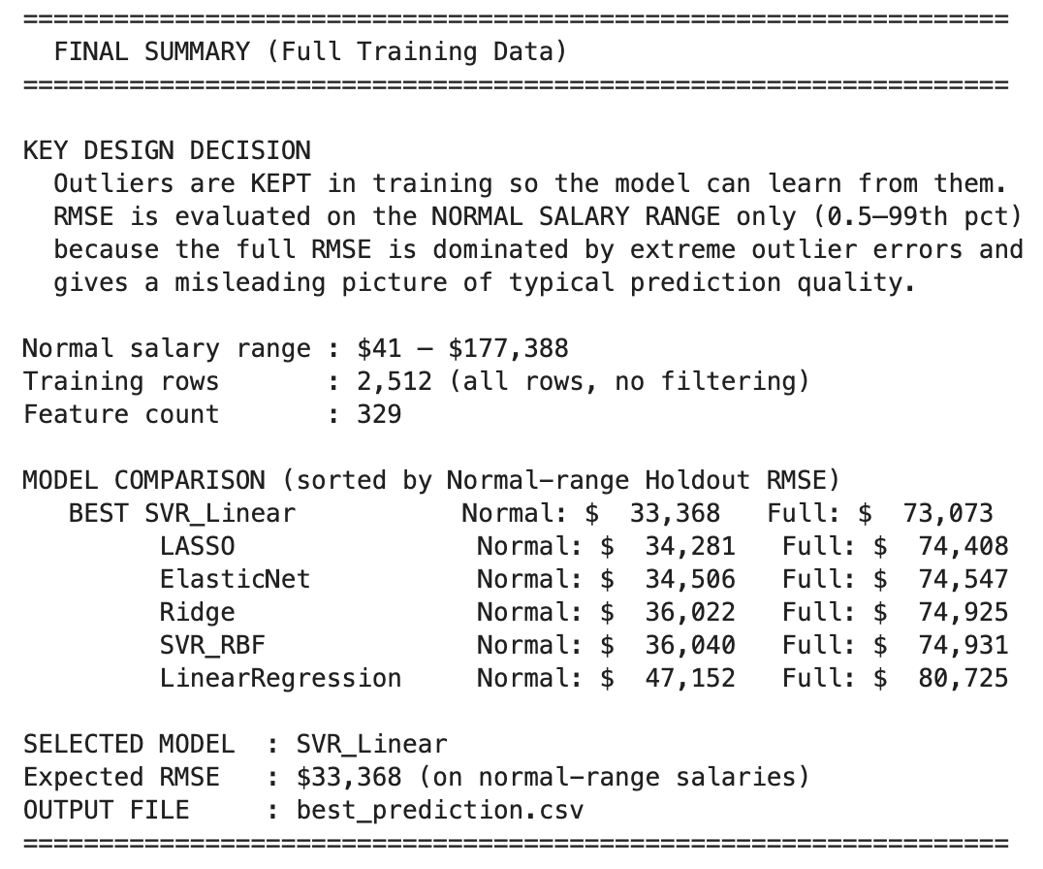
Model Results
SVR Linear: $33, 368 with best params: C=0.1
LASSO: Normal RMSE: $34,281 best params: α=0.01
Elastic Net · Normal RMSE: $34,506 best params: α=0.05, l1=0.3
KNN: Normal RMSE: $35,727
Ridge: Normal RMSE: $36,022 best params: α=100
SVR RBF: Normal RMSE: $36,040
Linear Regression (baseline): Normal RMSE: $47,152
All models retrained on full 2,512 rows before final predictions

Slide 12
CONCLUSION - Task 2
We compared three Machine Learning classifiers on the same preprocessed features and selected the winner using validation balanced accuracy. Linear SVM (svc_linear, C = 1.0) performed better (0.6719) and stayed consistent on the internal test (0.6768). The model detects many closed restaurants (recall ≈ 0.69) but closed predictions include false alarms (precision ≈ 0.18), which is expected with strong class imbalance.

Slide 13
Conclusion - Task 1
SVR Linear selected as best model with the RMSE score of $33,368
All 2,512 training rows used and no data discarded
Mathematically the RMSE (~$73k) is shown for transparency · inflated by 39 outlier rows
329 features engineered from 41 raw columns
Strict 70/15/15 split with CV=5 with no data leakage and reliable performance estimates
628 predictions generated and saved to submission.csv
Notes:
The Normal RMSE of $33,368 is the reported metric, computed on rows where the true salary falls between $41 and $177,388, which covers 98.5% of the data.

